Slide 1
Lecture 10
Project Management & Planning
Mobeen Nazar Lecturer
Software Engineering Department

Slide 2
Objective
Software Teams
Project Management Activities
Project Management Concerns
Project Planning
Work Breakdown Structure

Slide 3
Project
Definition: A group of tasks performed in a definable time period in order to meet a specific set of objectives
Project Features:
likely to be unique (one-time program)
have specific start and end time (life cycle)
have work scope that can be categorized into definable tasks
has a budget, require use of resources
3

Slide 4
The Four P’s
People — the most important element of a successful project
Product — a product is a good, service, platform, application, system, etc., that is created, generally for sale, to meet customer and business needs.
Process — the set of framework activities and software engineering tasks to get the job done
Project — project is unique in that it is not a routine operation, but a specific set of operations designed to accomplish a singular goal.
4

Slide 5

Software Teams
How to lead?
How to organize?
How to collaborate?
How to motivate?
How to create good ideas?
5

Slide 6
Management
The planning, organizing, staffing, directing and controlling of a company’s resources to meet the company’s objectives
6

Slide 7
Definition of Project Management
The planning, organizing, directing, and controlling of resources for a specific time period to meet a specific set of one-time objectives
7

Slide 8
Software Teams
The following factors must be considered when selecting a software project team structure ...
the difficulty of the problem to be solved
the size of the resultant program(s) in lines of code or function points
the time that the team will stay together (team lifetime)
the degree to which the problem can be modularized
the required quality and reliability of the system to be built
the rigidity of the delivery date
the degree of sociability (communication) required for the project
9

Slide 9
Groupcomposition
In creating a group for assistive technology development, Alice is aware of the importance of selecting members with complementary personalities. When interviewing potential group members, she tried to assess whether they were task-oriented, self-oriented, or interaction- oriented. She felt that she was primarily a self-oriented type because she considered the project to be a way of getting noticed by senior management and possibly promoted. She therefore looked for one or perhaps two interaction-oriented personalities, with task-oriented individuals to complete the team. The final assessment that she arrived at was:
Alice—self-oriented Brian—task-oriented Bob—task-oriented Carol—interaction oriented
Dorothy—self-oriented Ed—interaction-oriented Fred—task-oriented
Chapter 22 Project management

Slide 10
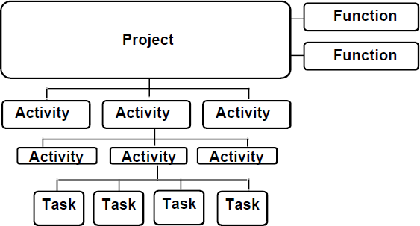
the duration of the
Project
Activity or set of activities that span
Large enough to avoid micro management
Write user manual , Write meeting minutes and post them
Project
For instance :
Project management Documentation , Training
Quality Control (Verification and validation) Configuration Management
Smallest unit of work subject to management
Small enough for adequate planning and tracking

Slide 11
Project Management Activities
Establish project objectives
Defining work requirement
Determining work timing
Establishing resource availability and requirements
Establishing a cost baseline
Evaluating and optimising the baseline plan
11

Slide 12
Project Management Activities
(Continued)
Freezing the baseline plan
Tracking the actual costs
Comparing the progress and cost to the baseline plan
Evaluating performance
Forecasting, analysing and recommending corrective action
12

Slide 13
The Process
Once a process framework has been established
Consider project characteristics
Determine the degree of consistency required
Define a task set for each software engineering activity
Task set =
Software engineering tasks
Work products
Quality assurance points
Milestones
15

Slide 14
The Project
Projects get into trouble when …
Software people don’t understand their customer’s needs.
The product scope is poorly defined.
Changes are managed poorly.
The chosen technology changes.
Business needs change
Deadlines are unrealistic.
Users are resistant.
Sponsorship is lost
The project team lacks people with appropriate skills.
Managers avoid best practices and lessons learned.

Slide 15



Project Management Concerns
product quality?
risk assessment? measurement?
cost estimation?
project scheduling? customer communication? staffing?
other resources? project monitoring?

Slide 16
To Get to the Essence of a Project
Why is the system being developed?
What will be done?
When will it be accomplished?
Who is responsible?
Where are they organizationally located?
How will the job be done technically and managerially?
How much of each resource (e.g., people, software, tools, database) will be needed?
Barry Boehm [Boe96]

Slide 17
Resources of A Company
Money
Manpower
Equipment
Facilities
Materials
Information/technology

Slide 18
Project Management Skills
Communication Skills
Organizational Skills
Team Building Skills
Leadership Skills
Coping Skills
Technological Skills

Slide 19
Project Planning and Control System
Goals/ Objectives
Work Description and Instructions
Network Scheduling
Master/ Detailed Schedules
Management Decision- Making
System Reports
Time/Cost/ Performance Tracking
Budgets
21

Slide 20
Hierarchical Planning System
Goals must be specified.
Identifying the set of required activities to achieve the goals.
Each activities and events can be decomposed into sub-activities and sub- events.
22

Slide 21
Planning Steps
Establish objectives
Develop a plan
Construct project planning diagram
Identify timing duration of each activity in planning diagram
Identify costs and labor/personnel associated with each activity
21

Slide 22
Establish Objectives
State objectives
Project start/end dates
Budgets
Technical results
List milestones
Milestone: a scheduled event for which some person is held accountable and which is used to measure and control progress.
Designate responsible personnel to meet objectives
22

Slide 23
Develop A Plan
List activities
Develop Work Breakdown Structure (WBS): The WBS reflects the decomposition of a project into subtasks down to the level for effective planning and control.
Determine relationships of activities
job precedence/succession
concurrent jobs
23

Slide 24
WBS Example
Manageable
Integrateable
Level 1
ABC Project
Level 2
Definition
Analysis
Design
Programming
Level 3
Requirements Documentation
Feasibility Study
Risk Analysis
Measureable
Independent
26

Slide 25
WBS of a simple project
Project
Design
Test plan
Code
Test
Code A
Code B
Each activity has a duration and consumes resources.
Each activity has a constraint(example: one must be finished before the other starts; so activities are executed in order).

Slide 26
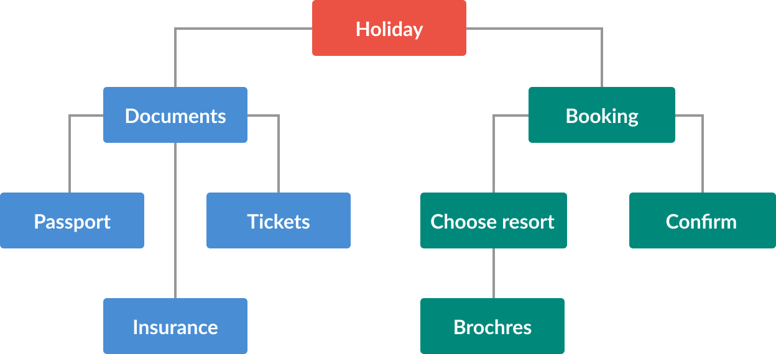
Example of WBS: “Holiday”

Slide 27
List of activities
Booking:
get brochures
choose resort
make booking
confirm booking
Travel documents:
check passport
book tickets
get insurance

Slide 28
Enter Earned Value Analysis
“Earned Value Analysis” is:
an industry standard way to:
measure a project’s progress,
forecast its completion date and final cost, and
provide schedule and budget variances along the way.
By integrating three measurements, it provides consistent, numerical indicators with which you can evaluate and compare projects.

Slide 29
What’s More Important?
Knowing where you are on schedule?
Knowing where you are on budget?
Knowing where you are on work accomplished?

Slide 30
EVA Integrates All Three
It compares the PLANNED amount of work with what has actually been COMPLETED, to determine if COST , SCHEDULE, and WORK ACCOMPLISHED are progressing as planned.
Work is “Earned” or credited as it is completed.

Slide 31

Earned Value is needed because...
Provides an “Early Warning” signal for prompt corrective action.
Still time to recover
Timely request for additional
funds

Slide 32
But First! - We Must Get Organized
EVA works best when work is ‘classified’.
classification is best achieved with a well- planned Work Breakdown Structure.
So, how do I create a WBS for a really complex
project?

Slide 33
Proper WBS Design
One WBS per program
Deliverable-oriented
Work not in the WBS is out-of-scope
Each descending level represents more detail
Full (and accurate) definition is key
Defined deliverable(s)
Timeframe for delivery of product
Total cost (direct and indirect) to deliver product
WBS Have three measurable components
Scope of work to be accomplished
Total (direct and indirect) cost
Timeframe for completion

Slide 34
Some New Terms
PV – Planned Value
AC - Actual Cost EV – Earned Value

Slide 35
Earned Value Definitions
PV: “Planned Value”
Planned cost of the total amount of work scheduled to be performed by the milestone date.
AC: “Actual Cost of Work Performed”
Cost attained to accomplish the work that has been done to date.
EV: Earned value or Budgeted Cost of Work Performed
The planned (not actual) cost to complete the work that has been done.

Slide 36
Some Derived Metrics
SV: Schedule Variance (EV-PV)
–A comparison of amount of work performed during a given period of time to what was scheduled to be performed.
–A negative variance means the project is behind schedule
CV: Cost Variance (EV-AC)
–A comparison of the budgeted cost of work performed with actual cost.
–A negative variance means the project is over budget.

Slide 37
Schedule Variance & Cost Variance
Schedule Variance = EV-PV
$49,000
- 55,000
SV = - $ 6,000
Cost Variance
= EV-AC
$49,000
56,000
CV = - $7,000

Slide 38
Some More Derived Metrics
SPI: Schedule Performance Index
SPI=EV/PV
– If SPI<1 means project is behind schedule
CPI: Cost Performance Index
CPI=EV/AC
–If CPI<1 means project is over budget
CSI: Cost Schedule Index (CSI=CPI x SPI)
The further CSI is from 1.0, the less likely project recovery becomes.

Slide 39
Performance Metrics
SPI: EV/PV
49,000/55,000 = 0.891
CPI: EV/AC
49,000/56000 = 0.875
CSI: SPI x CPI
.891 x .875 = 0.780

